Slide 1
Travel Insurance Analytics Report
Prepared by
Oluwatoyin Ademarati
February 26, 2022

Slide 2
Overview
This analytics report shows the differences in the travel habits of people who have subscribed to a travel insurance package and those who have not.
I will be sharing insights from some travel insurance data of people who have insurance(customers) and those who have gotten quotes but have not bought insurance(non-customers).
I will be looking into who their customers are, their ages, income, family size, education and travel behavior and recommend who marketing target should be.

Slide 3
Scope
This report is focused on the travel habit of people who have travel insurance and their demography.
Methodology
The company has provided data on their current customers as well as people who got quotes but never bought insurance in csv format. The 'TravelInsurance' column of the dataset contain labels of whether a person is a customer(ie. Has insurance) or is not a customer(ie has quote but not insurance).
I have used python data analytic and visualization tools(pandas, seaborn, matplotlib) to analyze the data.
Analysis
The analysis shows that people who travel often and people who have travelled abroad are more likely to pay for travel insurance. Also the age range of customers is 26 to 34 with more of 34 years olds likely to subscribe to a travel insurance. Individuals who are graduate and work in the Private Sector or are Self employed too are more likely to subscribe.

Slide 4
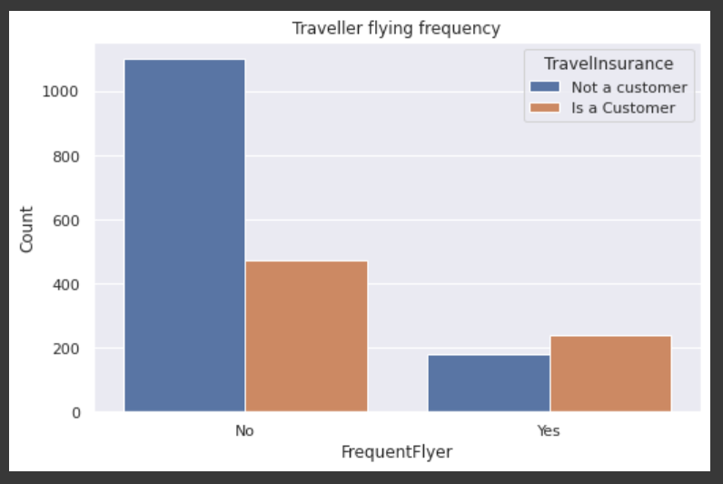
Findings
Finding 1
Most individual fly more frequently. However of those that fly frequently, customers are more.

Slide 5
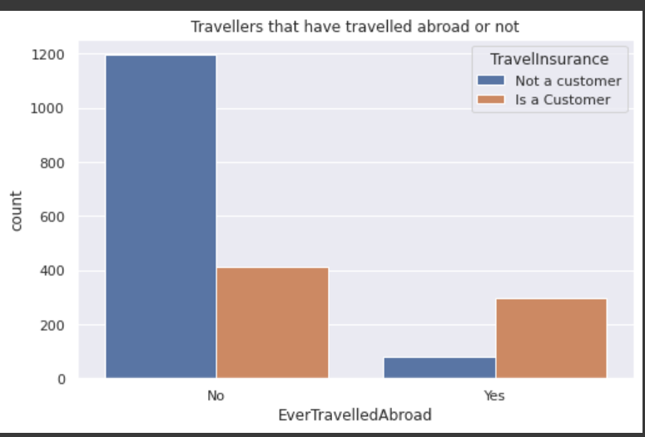
Finding 2
More customers have travelled abroad.

Slide 6
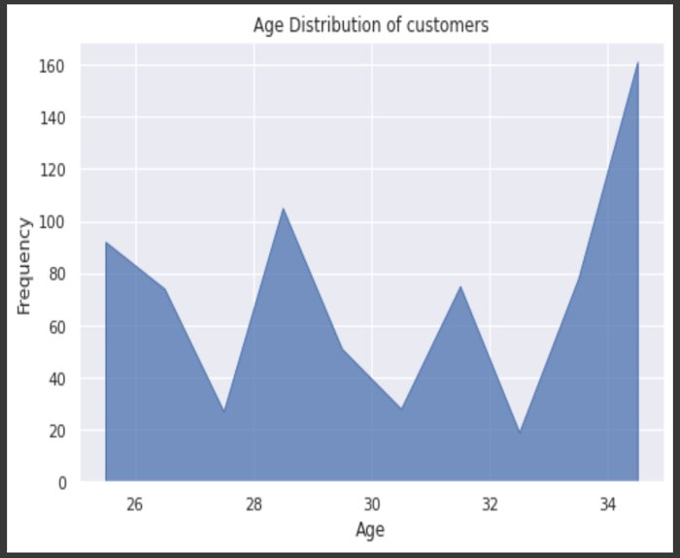
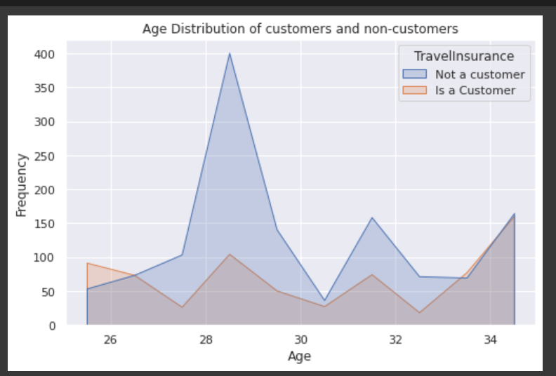
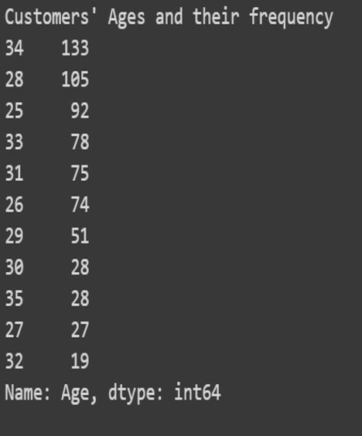
Finding 3
Even though there is almost an even distribution in the ages of customers, the distribution of their ages shows that most of their clients are between the ages of 26 and 34 with the peak of customers being 34 and the peak of non-customers being 28

Slide 7
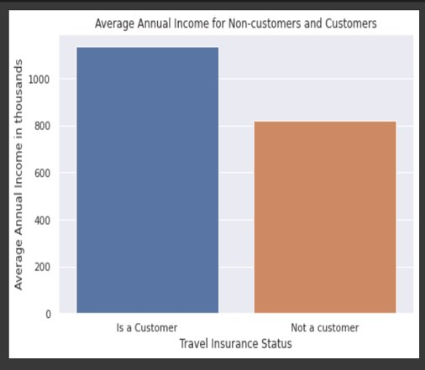
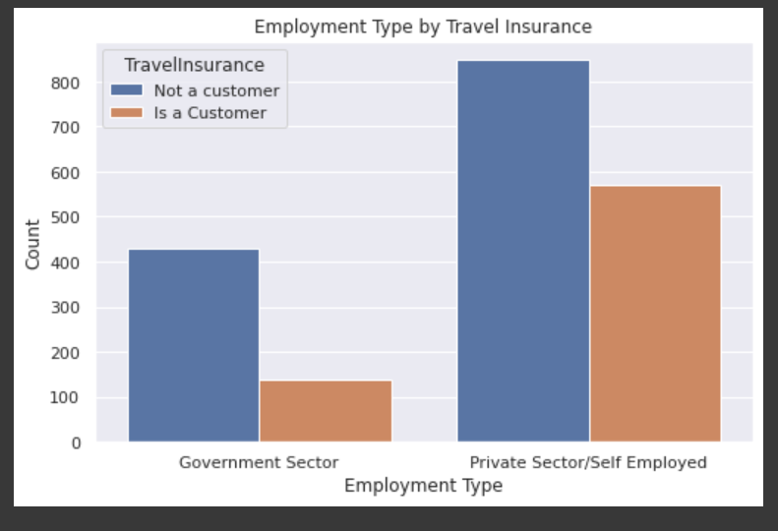
Finding 5
The average annual income of those who are already customers are higher than the average annual salary of those who just took quotes.
This means people with higher income are likely to subscribe to travel insurance than others
Finding 4
Majority of the customers work in the Private Sectors or are Self Employed with fewer people from Government Sectors.

Slide 8
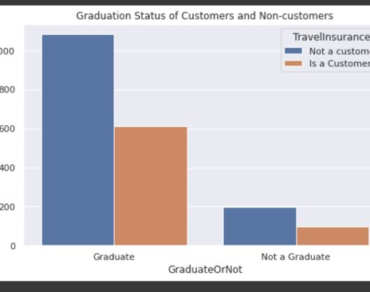
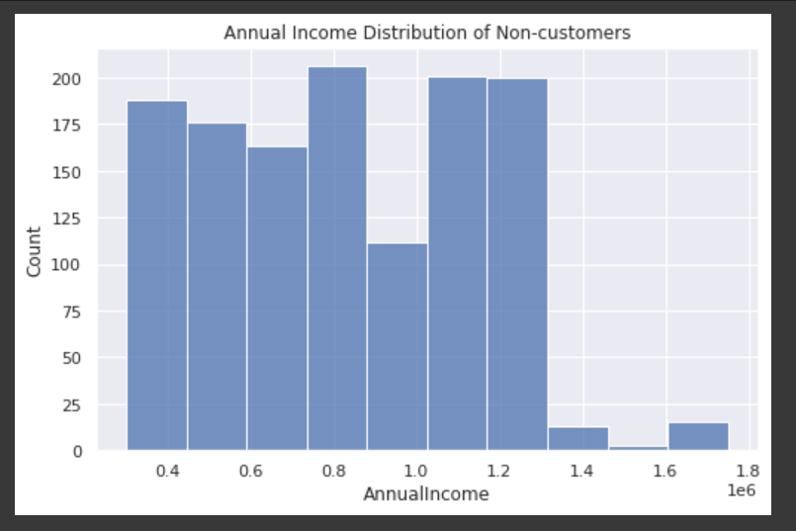
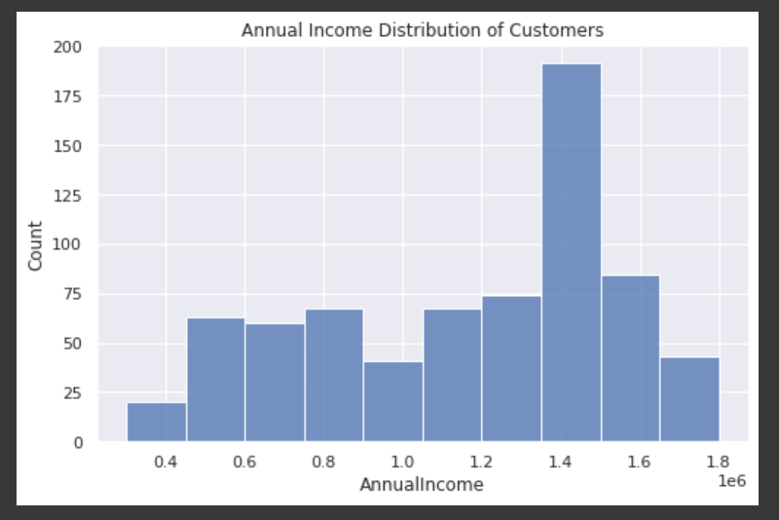
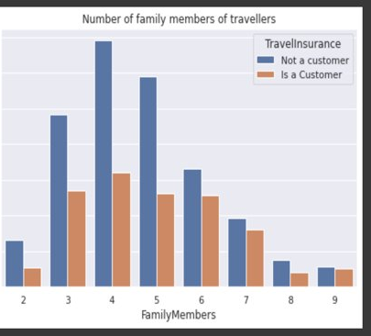
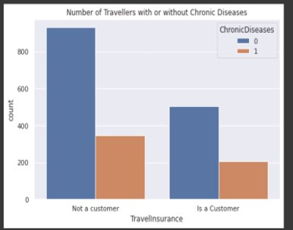
Other Charts

Slide 9
Conclusion and Recommendation
The marketing should be targeted towards these people:
1. Those who travel often
2. Those who travel abroad
3. Individuals between the ages of 26 and 34 with greater focus on those who are 34 years and 28 years old.
4. Those who work in the Private Sector or are Self employed

